Slide 1

Library system
Joshua Reiss
Alex Lawrence

Slide 2
Customer Requirement Statement Summary
Develop a library application including a GUI and system section for use at the library and from a user’s computer. Necessary components include system requirements, design, code, and testing. Users include, patrons, employees, and administrators. The application must include the following capabilities; login, search, reserve books, admin tasks, work log, and event information.

Slide 3
Release Implementation Plan
Due to staff and schedule limitations, the initial implementation and release of the library system application will execute on computers locally in libraries. The release will implement the full feature list per the customer requirement statement except book reservation, email notification, and search by genre.

Slide 4
System Purpose
The main purpose of the system is to make the library experience more pleasurable, efficient, and appealing. The target audience for the system includes:
Library users
Library employees
Library administrator (employers)
Community organizations

Slide 5
System Feature List
This is a list of the main features the library application provides:
Library account management
Optimized book searching
Work log management
Administrator capabilities
Event information

Slide 6
Library Account Management
This feature allows a user to create a library account. These are the options available for this feature:
Account registration
Password Reset
User id retrieval
User login

Slide 7
Optimize Book Searching
This feature allows a user to search for books from a computer rather than walking through library to find their selection. These are the options available for this feature:
Displays all available books
Search library for books by
Book title
Year published
Author
An ISBN

Slide 8
Work Log Management
This feature provides library staff the ability to manage daily work tasks. These are the options available for this feature:
Add daily tasks with priority level
View daily tasks in order of priority
Mark task complete

Slide 9
Administrator Capabilities
This features provide administrator accounts with evaluated options. These are the options available for this feature:
View and change fees
View all accounts
Search accounts
Change account status

Slide 10
Event Notification
This features allows the library staff and community members to post event information. These are the options available for this feature:
Add new events
Displays all upcoming events
Events removed after occurrence

Slide 11
Code Breakdown
The following is a list of tools used for creating the Library system:
Java programming language in NetBeans
GUI creation with Java swing
Build and packaging with Maven
Class testing with junit
Configuartion management with github
65 classes
SLOC count is: *insert*

Slide 12
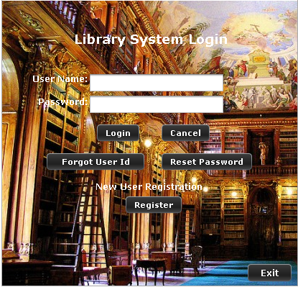
Login Screen

Slide 13
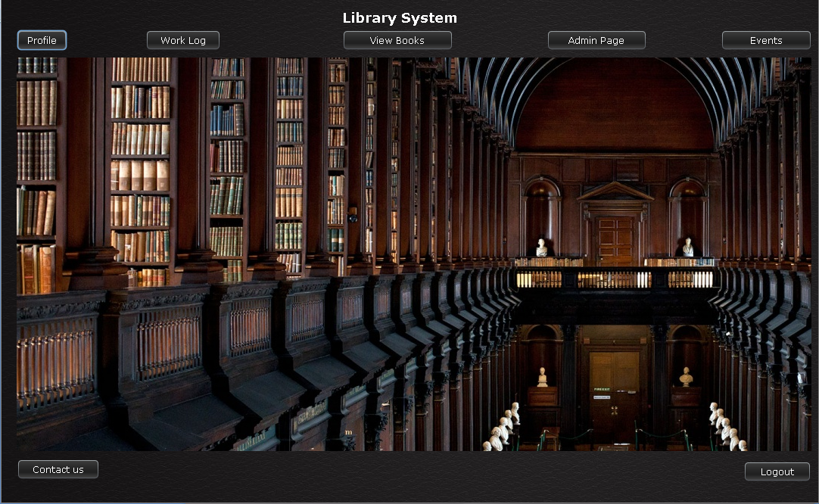
Main Interface

Slide 14
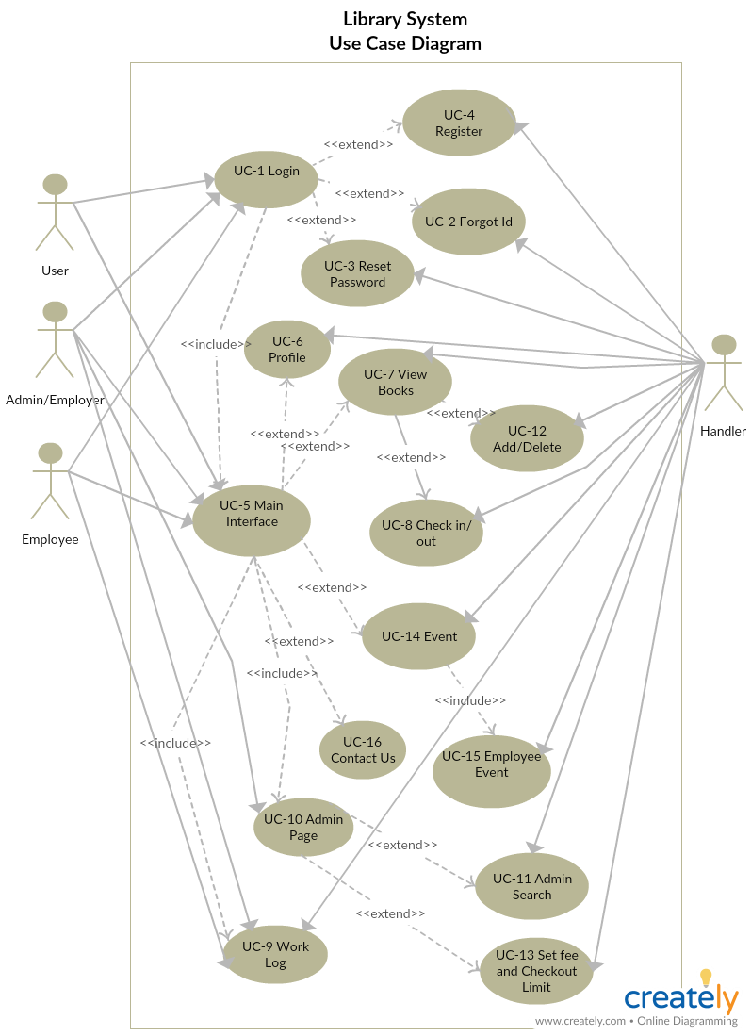
Main Interface

Slide 15
Library Code Overview
The handler is used as the interface to the GUI and maintains maximize efficiency. These are the main highlights to the code:
All reading and writing occurs in one class
Methods would call pre-existing methods for their parameters when possible.
Unique object classes such as Events and Books have equals() and compareTo() methods Overrided for more convenient code.

Slide 16
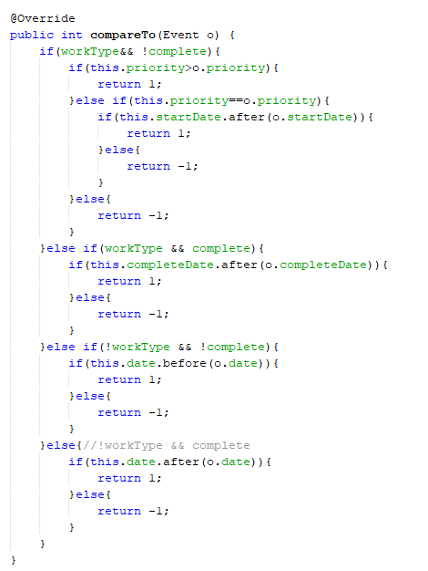
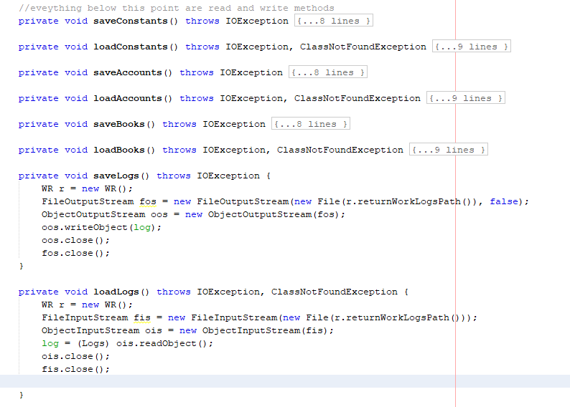
Pictures of code

Slide 17
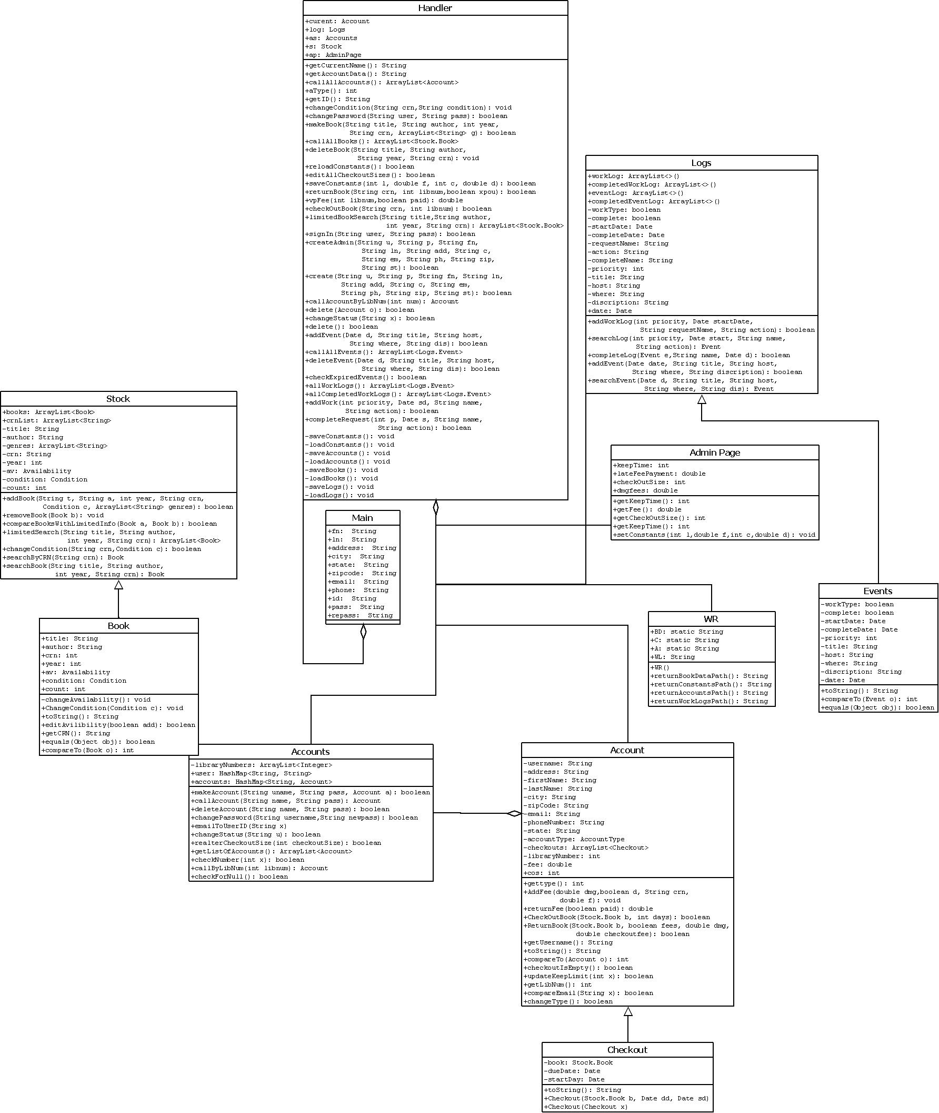
Library Code Overview

Slide 18
Future Implementation Plan
The second release will include a server based application that executes on any user’s computer. All the features from release one will be preserved. The following features will be added:
Book reservation
Book notification emails
Search by genre
Hot books

Slide 19
QUESTIONS

